Slide 1
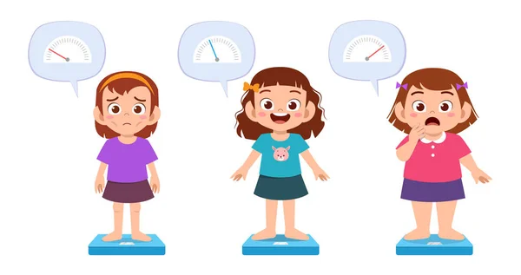
Child Malnutrition
Data Science
Prepared by: UTM_Junior

Slide 2




Group Members
Chong Xian Jun
Lim Jia Yee
UTM Master of Data Science
chong.jun@graduate.utm.my
UTM Master of Data Science
jiayeelim@graduate.utm.my
Ang Woei Haw
Tan Fei Zhi
UTM Master of Data Science
feizhi98@gmail.com
UTM Master of Data Science
anghaw@graduate.utm.my

Slide 3
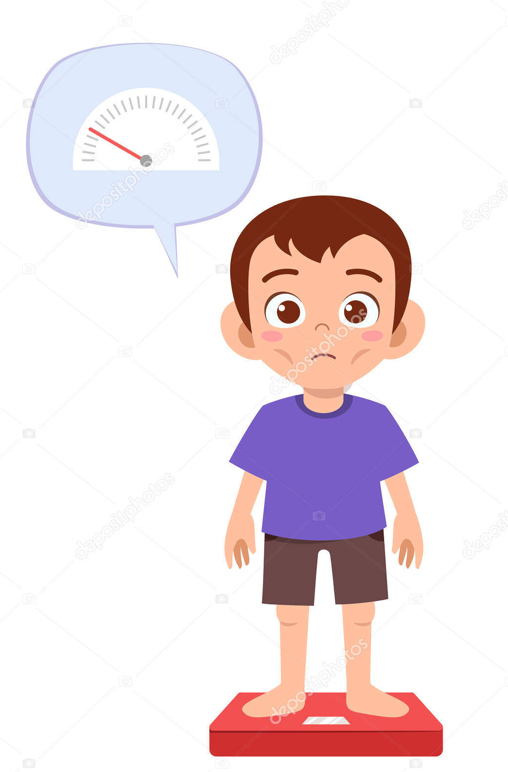

Current Issues
Malnutrition has proven to be one of the leading issues that are directly or concomitantly responsible for more than half of all deaths worldwide, especially among children under age five. It can be classified into several forms, i.e. overweight, underweight, stunting, wasting.
WHO estimated that 45% death among children were caused by undernutrition. This mostly happen in low and middle-income countries.

Slide 4

Introduction
Children is our future
According to WHO, the Sustainable Development Goals(SDG) is to end child wasting. To achieve this goal, WHO targets to reduce the proportion of children suffering from wasting to <5% by 2025 and <3% by 2030.
<5%
<3%
By 2025
By 2030

Slide 5

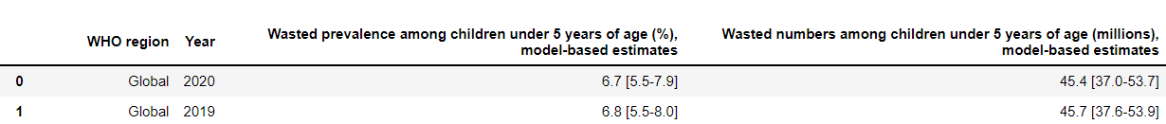
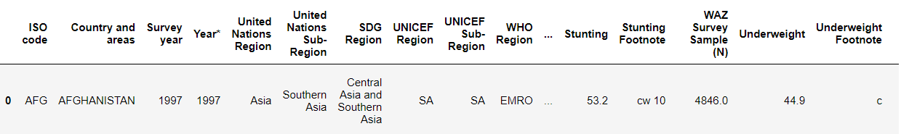
Dataset
The datasets are extracted from the sources below:
https://apps.who.int/gho/data/node.main.ngest?lang=en
https://data.unicef.org/resources/dataset/malnutrition-data/

Slide 6

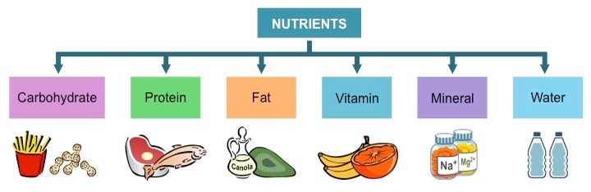
Problem Formulation & Solution
Problem Formulation
Solution
Using data science to deter child malnutrition
To raise awareness regarding the condition of child malnutrition around the world
To design tools for facilitating informed decisions by policies makers
Notes:
Problem formulation
Ever increasing rate of diabetes shows that there is something fundamentally wrong with our lives that are enabling diabetes. In order to uncover the factors contributing to the problem, we carefully investigate the data and foster better understanding on diabetes and hopefully use these data to help fighting diabetes. (like this can transition to our analysis more smoothly)
Solutions are bolded
We can’t fight what we don’t know. Therefore, we delve deep into the data to investigate features that can help predicting diabetes, or even contributing to it. And then we try to construct the profiles of the diabetic patient, in hope to raise awareness to the public about the people who are at high risk of being diabetic. Finally, knowing that the need of blood samping e is a huge detriment for the general public to frequently keep track of their diabetic risk, we also try to develop a learning model to predict if someone is likely to be diabetic without blood sample, e.g. weight, waist, blood pressure, etc. with hope to tackle the issue.

Slide 7
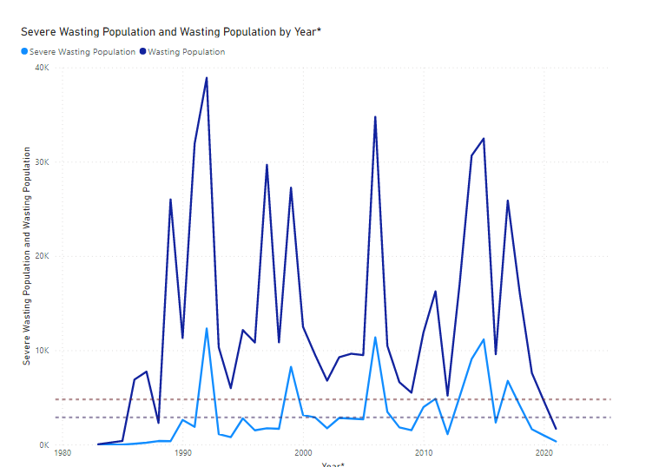
Severe Wasting and Wasting Population over Years
5% of population in year 2025
3% of population in year 2030

Slide 8
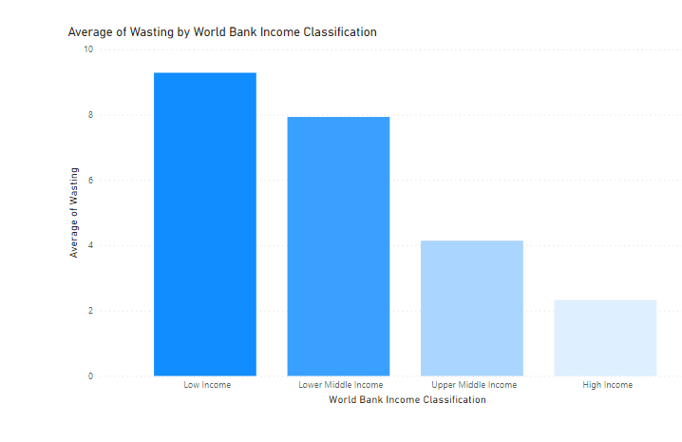
Wasting by World Bank Income Classification
The proportion of child malnutrition of a country is strongly correlated with its income

Slide 9
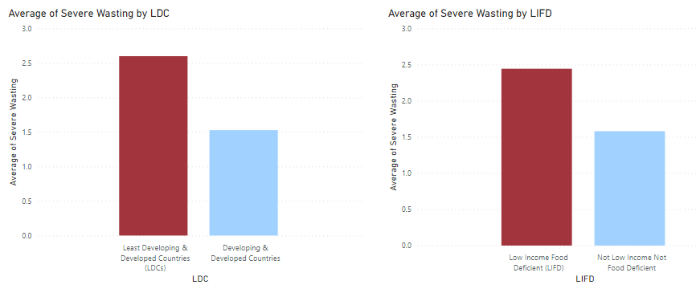
Child Malnutrition Does Not Limit to the Poor Countries
The attributes that affect the child nutrition

Slide 10
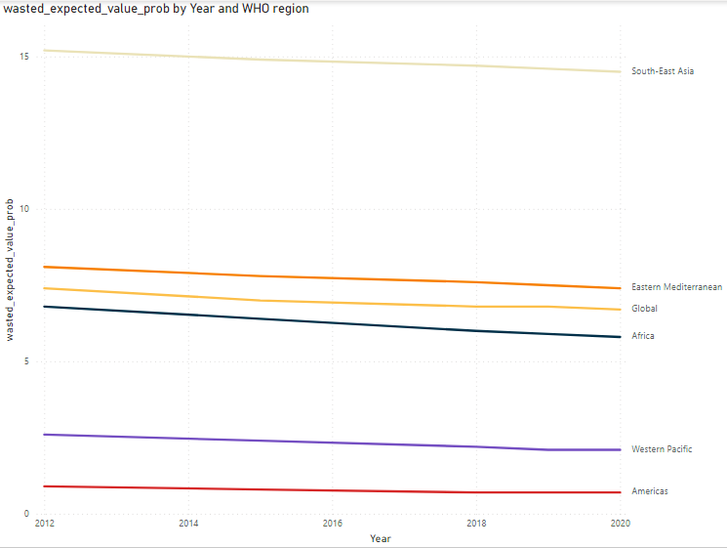
Child Malnutrition by WHO Regions
When we talk about malnutrition, we think of stereotype of Africa children.

Slide 11
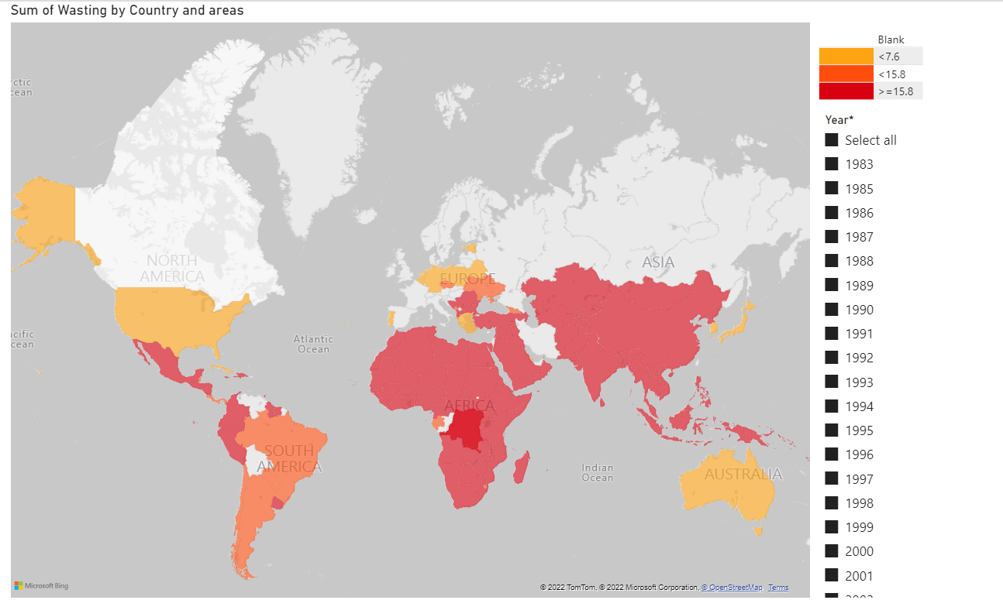
Child Wasting Around the Globe

Slide 12


Data Product
We can’t manage what we don’t see.
So we need ways to make the problem visible to the eyes of the policy makers.

Slide 13
Child Wasting Around the Globe (1983-2020)
https://app.powerbi.com/view?r=eyJrIjoiODZjNDZiNTItMzAyMy00NjcwLWJjNGEtZmM1ZjE2ZTFkZmU2IiwidCI6IjBlMGRiMmFkLWM0MTYtNDdjNy04OGVjLWNlYWM0ZWU3Njc2NyIsImMiOjEwfQ%3D%3D

Slide 14
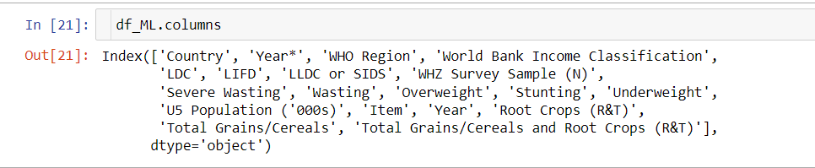
Finding the Undetected Wasted Children (on Country Level)
Due to the children experiencing wasting are mostly underprivileged and often goes under our radar, we may make use of ML algorithm to find some ways to possibly “detect the potentially undetected group”.
Potential indicators of wasting are used to predict the possibility of a country having a significant (>10%) of children under age 5 suffering wasting. On top of our existing data, data on food availability by country is augmented.
Features used to train ML model to predict proportion of child wasting

Slide 15
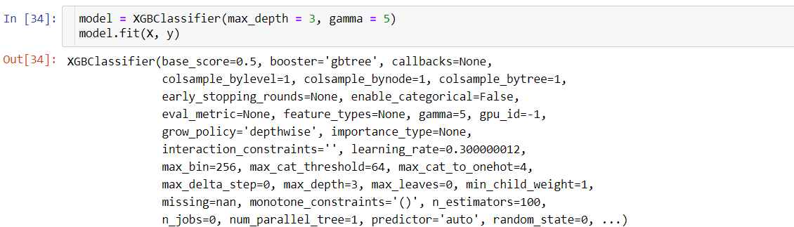
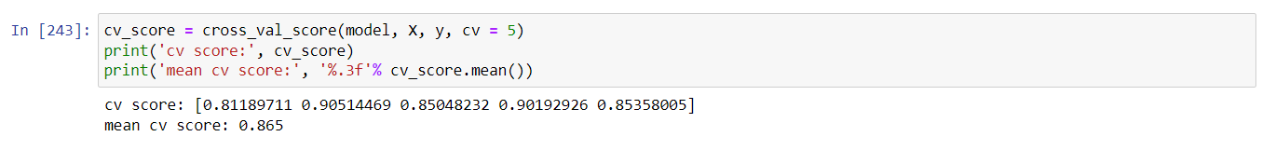
Prediction Model
An XGBoost model is proposed to predict the proportion of wasted child in each country in a given year.
After training, we carry out cross-validation test to evaluate the performance measured by accuracy. The result is stated below.

Slide 16
Recommendations
Coordinated Data Preparation
To allow greater visibility on the problem of child malnutrition and thus better management insights.
Popularize Open Sourced Data
Making the data more accessible, allowing public engagement to monitor or even alleviate the problem.
Complex Optimization
Stop treating child malnutrition as an isolated issue, but a complex optimization problem embedded deeply in socio-economy.

Slide 17

Thank You !!!

